Slide 1
The evolution of human-specific disease
Sarit Moses & Gil Sasson
Supervised by Dr. David Gokhman
T.A.: Nachshon Aiyges

Slide 2
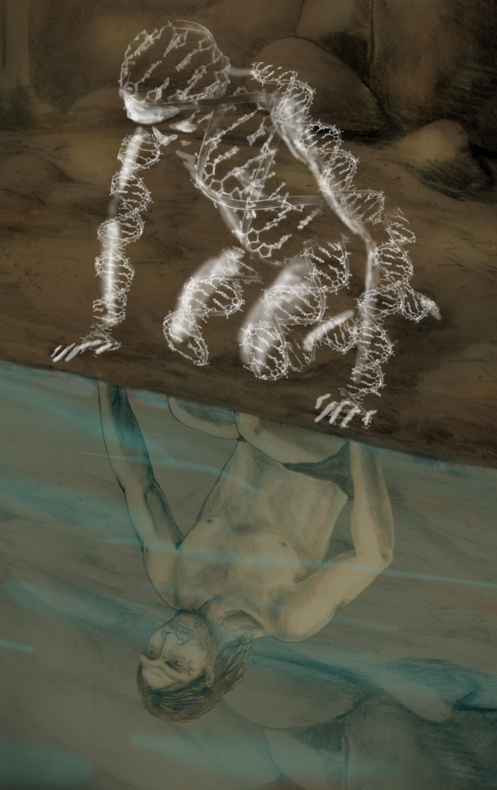
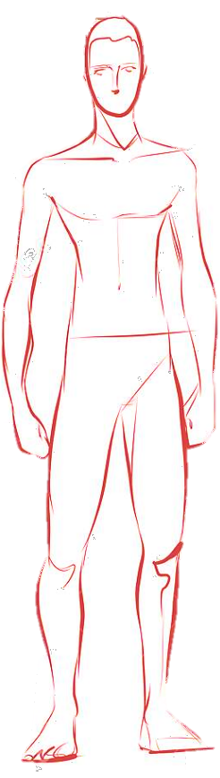
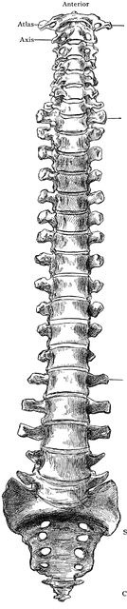
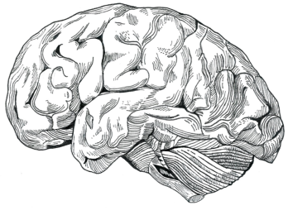
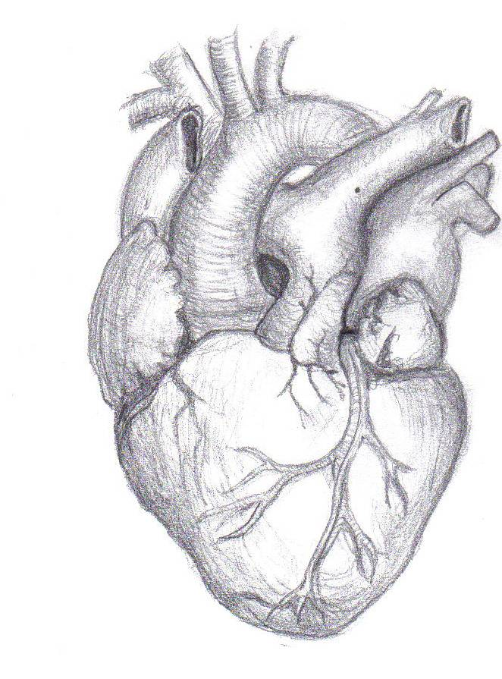
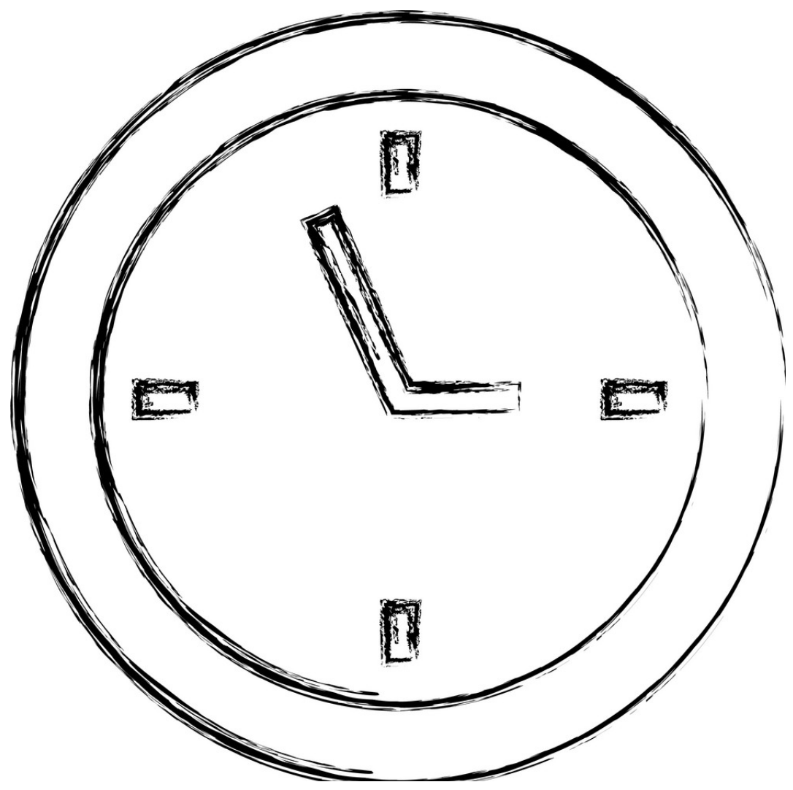
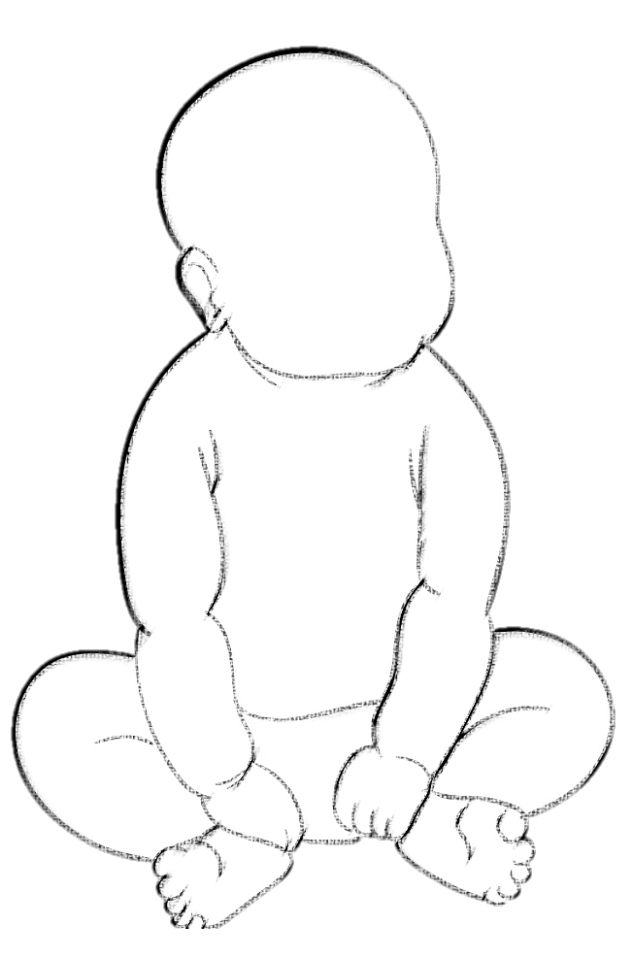
3x Brain
Upright walking
Alzheimer's disease
Schizophrenia
Chronic back pain
Disk hernia
Endurance
Extended
running
learning period
Preterm labor
Preeclampsia
Myocardial infarction
Notes:
Humans have evolved many exceptional adaptations, including our increased brain size, upright walking, adaptation to endurance running, and extended learning period.
At the same time, these adaptations also came with a high price tag - many disorders that are prevalent in humans, but uncommon or even nonexistent in other great apes.

Slide 3
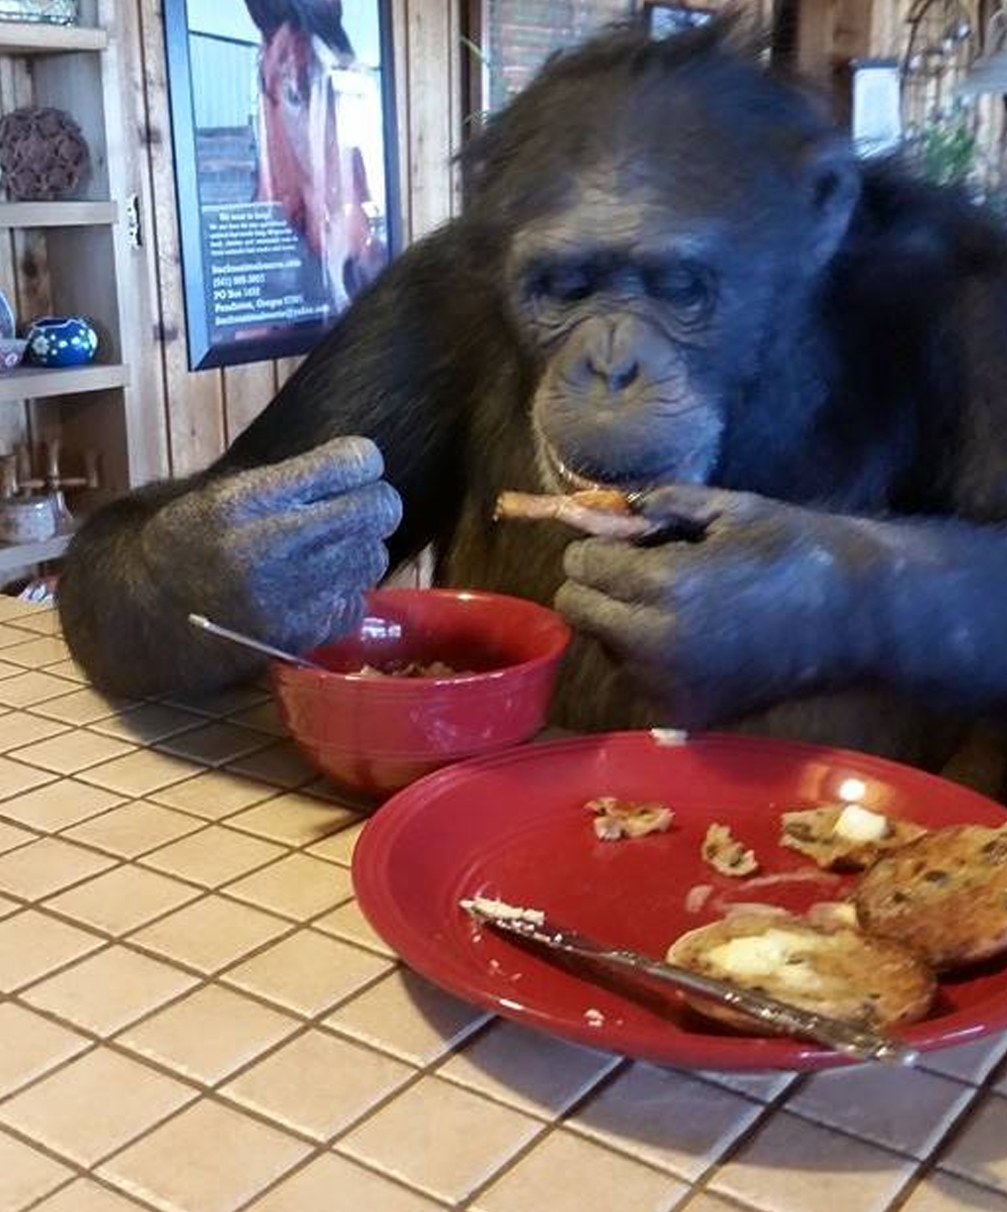
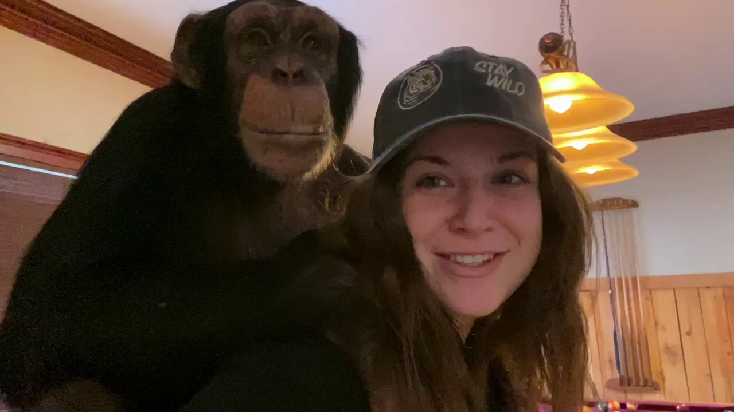
Human susceptibility is not explained by environmental differences
1
2
3
Why only humans?
Protection in
other apes
Cure
Genetic changes → human susceptibility
X
X
X
Environment
Longevity
Lack of data
Notes:
You might be thinking at this point that maybe these diseases are not really human-specific, but are just caused by our unique environment, diet, longevity, but actually, there are hundreds of apes that have been raised with humans practically as members of the family, eating human food, being exposed to urban toxins, living to the age of 60 or more, interacting with human pathogens, going through autopsy after death to identify cause of death – none of them get these diseases.
This suggests that these are indeed human-specific diseases and that genetic changes that emerged in our evolution have made us more susceptible to them
Our goal in this project is to try and understand why do only humans get these diseases, what is the mechanism that protects other apes from getting the disease, and if we find such mechanisms, can these protection mechanisms inform us in the development of a cure for the disease? After all, nature has already solved this problem for apes, so why not use it?

Slide 4

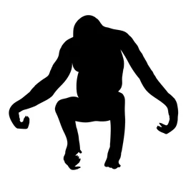
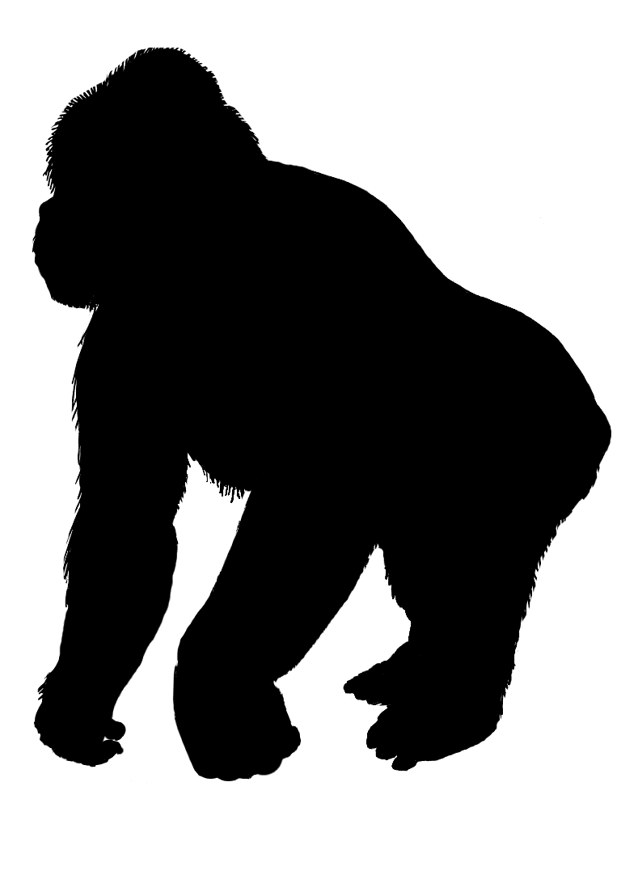
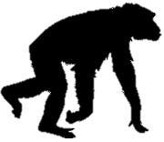
The emergence of human-specific diseases
Protected
Protected
Protected
Susceptible
Orangutan
Gorilla
Chimp
Human
Disease emerges
How did these changes emerge and spread? and Why?
The immediate suspect: changes to gene regulation
Notes:
The fact that genetic changes that make us more susceptible to a disease emerged in our evolution and spread in the human population is counterintuitive, as we would expect negative selection to purge these disease susceptibility alleles.
The question is how did these changes emerge, and what drove them?
The immediate suspect is changes to gene regulation, meaning changes to where, when and to what extent a gene is expressed. This is because changes to gene regulation are considered the main fuel of evolution.

Slide 5
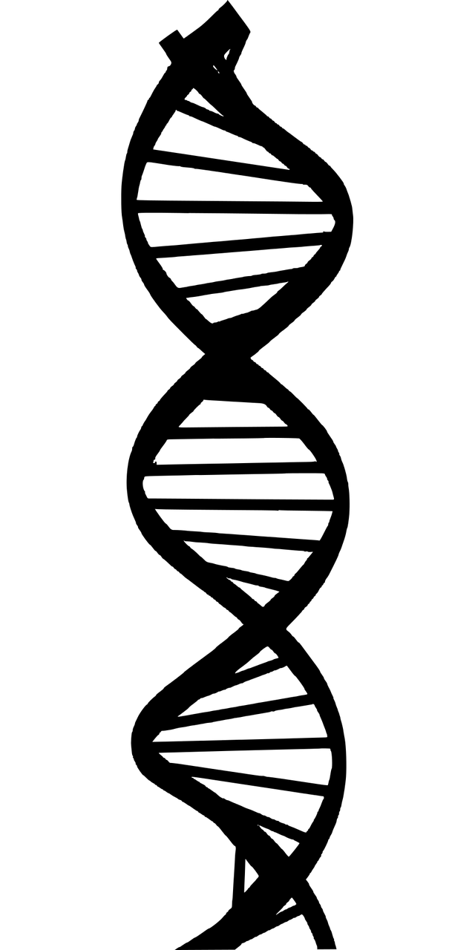



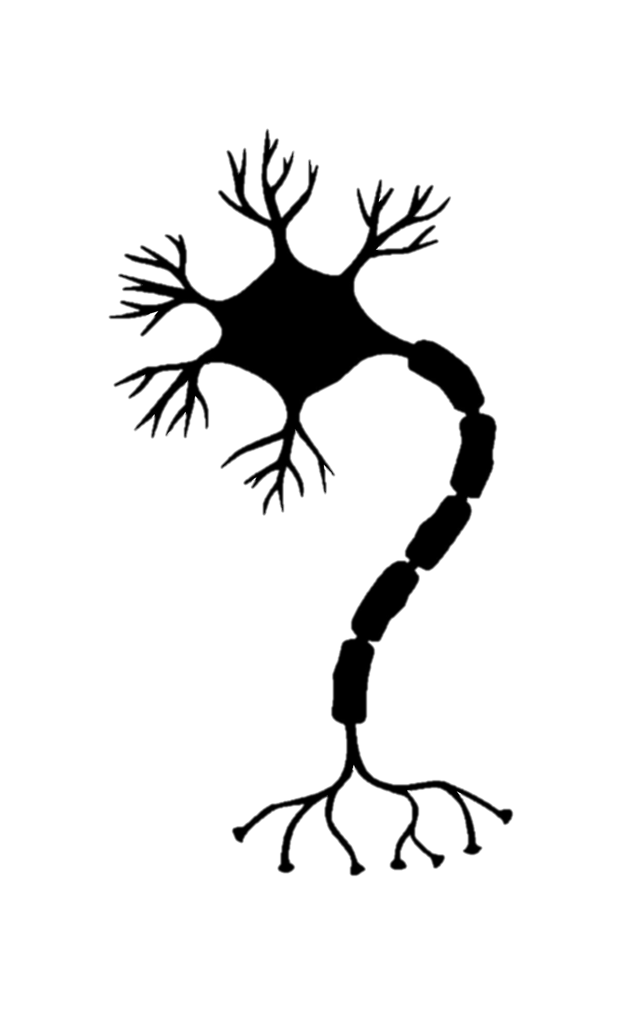
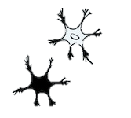

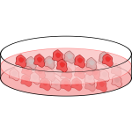
Changes to gene regulation – the main driver of evolution
Evolution
RNA
RNA
Confounders
Environment
Cell-type heterogeneity
Batch
Notes:
To find such changes, we can compare gene expression in a human sample to a chimp sample and identify differentially expressed genes.
However, when we do RNA-seq for example, we’re never certain if the difference we see is a true evolutionary difference, or perhaps something that is driven by environmental differences (for example, a different diet), cell composition differences between the human and chimpanzee samples in these specific samples, a difference response to cell culture or simply a batch effect. So, it is really difficult to determine if the difference we see in expression is a true evolutionary difference, or just artifact of an imperfect comparison.

Slide 6
Human-chimp hybrids enable robust comparisons between species
Fusion
FACS
Gokhman et al., Nature Genetics, 2021
Agoglia et al., Nature, 2021
Notes:
To address this, we have generated a powerful new resource: human-chimp hybrid cells. By creating a cell that contains both the human and chimp genomes within the same nucleus, we get a well-controlled system, where the two genomes are exposed to the exact same cellular and external environment. This means that any difference in expression between the human and chimp alleles has to be driven by evolutionary changes to the expression of that gene.

Slide 7
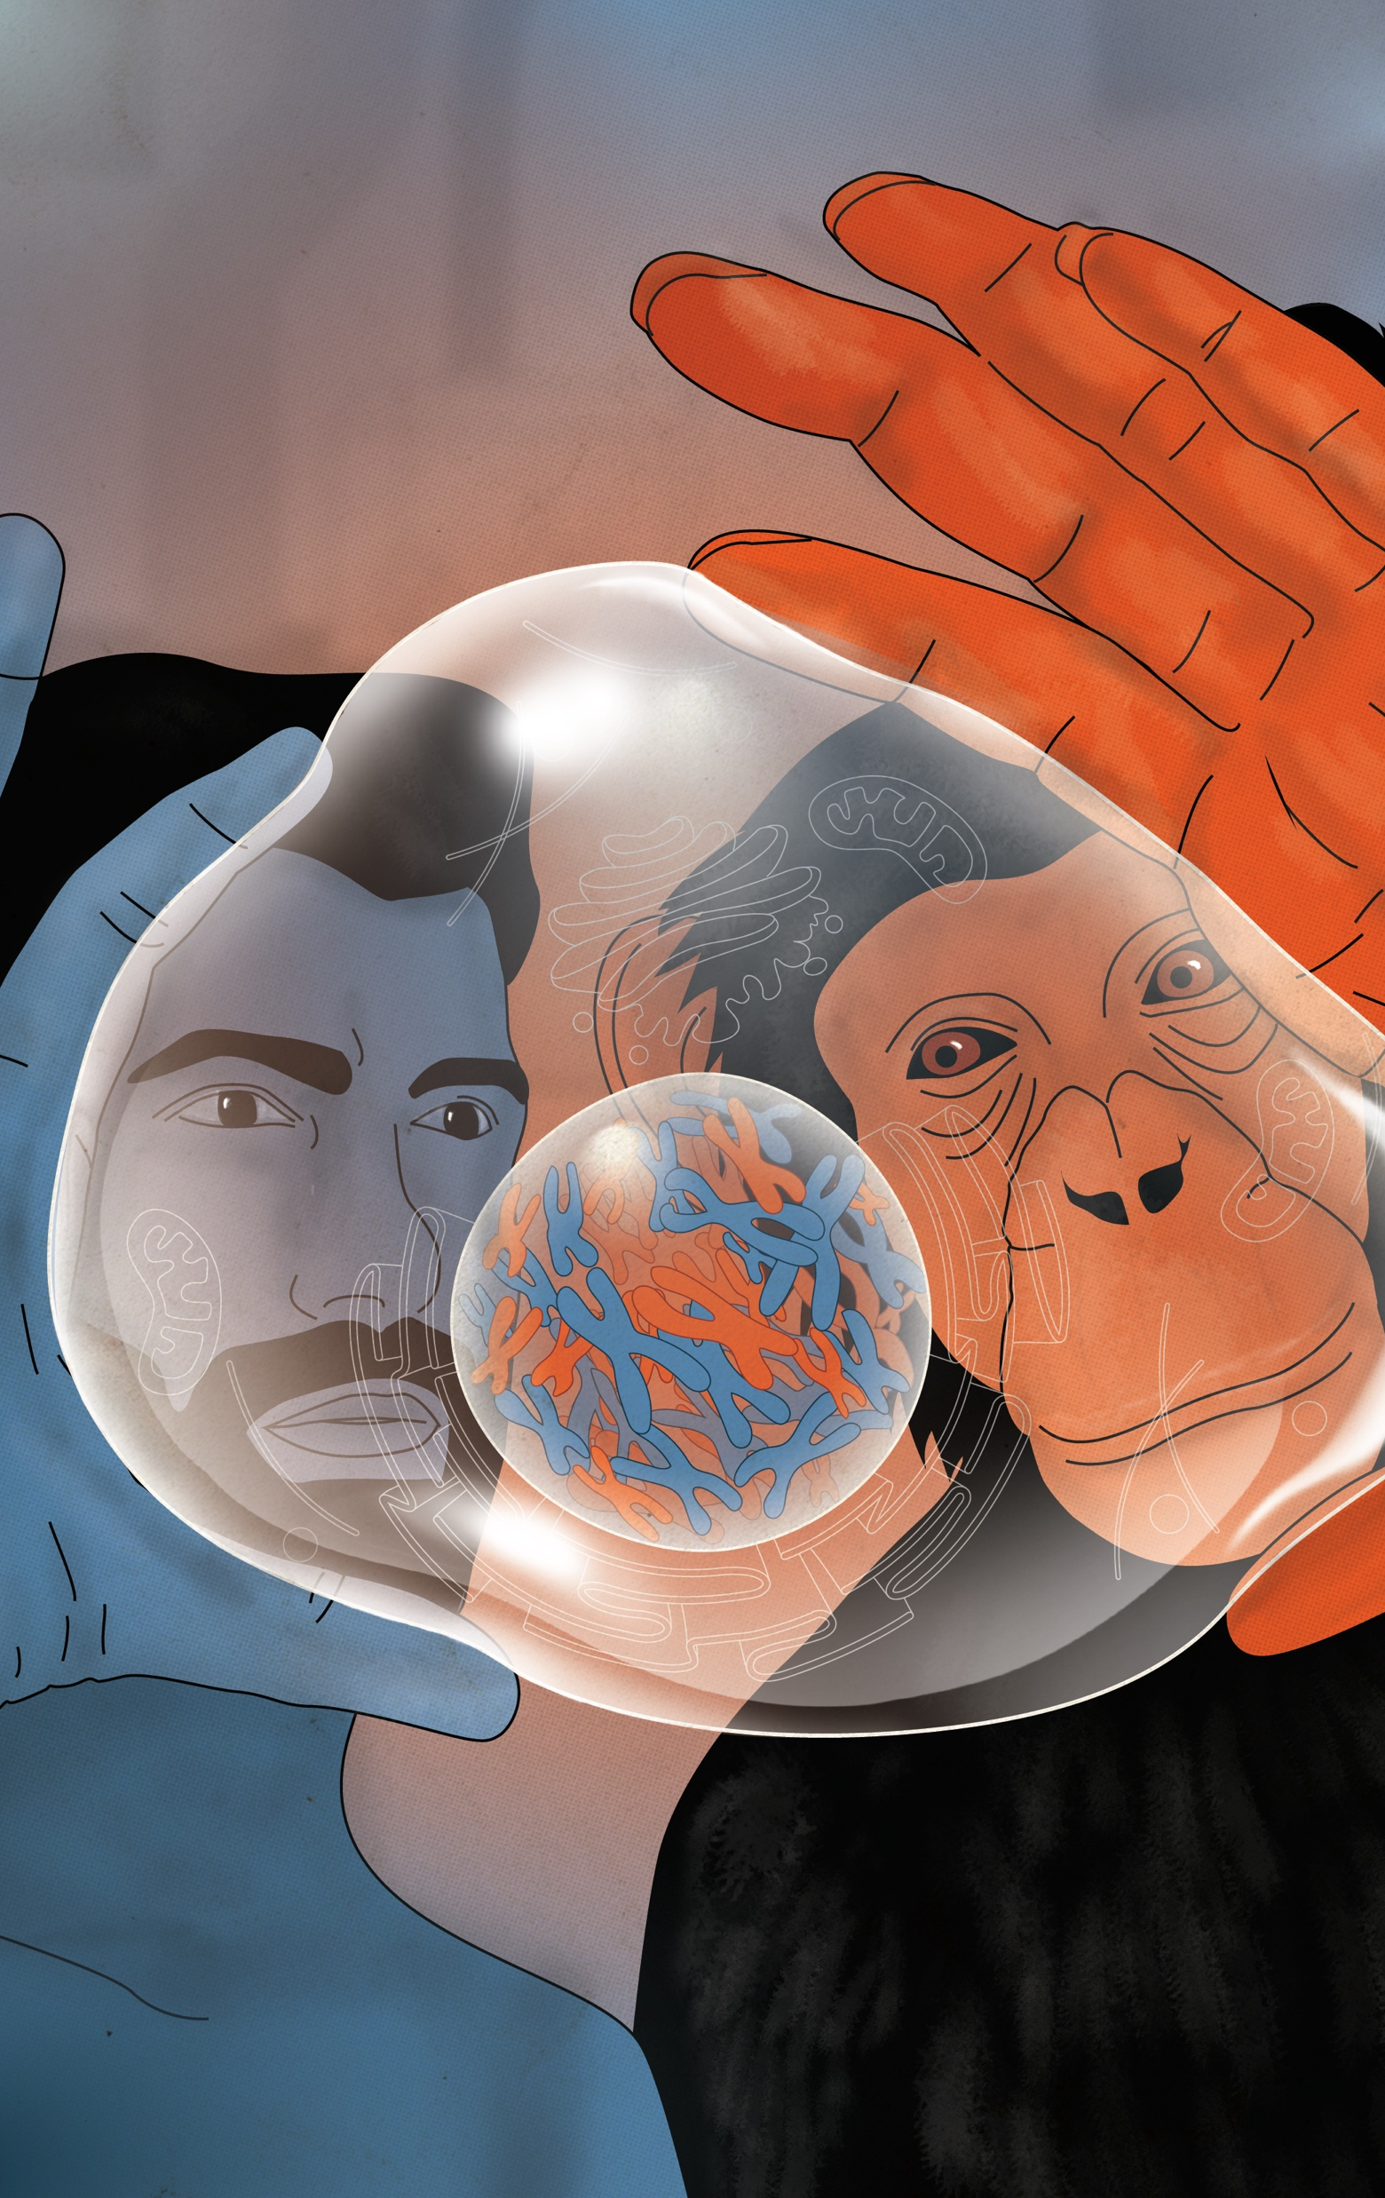
Using hybrids to map the expression changes that shaped disease genes
Expression in hybrid neurons
Alzheimer’s disease genes
Gene 1
Gene 2
Gene 3
Gene 4
Gene 5
…
Gene 100
Signature of adaptive change
Trade-off?
Notes:
So, we will use these human-chimp hybrid cells to identify the evolutionary changes that emerged in disease-causing genes. For example, if we see a case like this, where genes associated with Alzheimer’s disease have become mostly upregulated in humans, this would suggest a signature of selection driving these genes to up-regulation in humans. Perhaps, this reflects a trade-off, where upregulation of this pathway was adaptive, but also exposed us to Alzheimer’s

Slide 8
Background: human specific diseases
Chimps (and other great apes) are the closest to us, evolutionary speaking
They confer the model organism closest to humans
Some diseases are not present in chimps – why?
Could this tell us something about our own evolution and how it happened?
When we make changes in some place, they can affect (positively or negatively) other parts of the system
changes are most likely in regulatory changes and not mutations

Slide 9
Explain the idea of using hybrid human-chimp cells for studying regulatory evolutionary changes

Slide 10
Project outline – here comes infographics about our pipeline
Start from documentation of human specific diseases (varki, gokhman list)
Get list of related celltypes for each of the diseases
Check for GWAS data and ClinVar data to identify Associated genes
Use hybrid data
Find differences between disease-associated genes and non disease-associated genes
We tested 31 diseases in various celltypes, will focus on schizophrenia since this is where we have interesting results

Slide 11
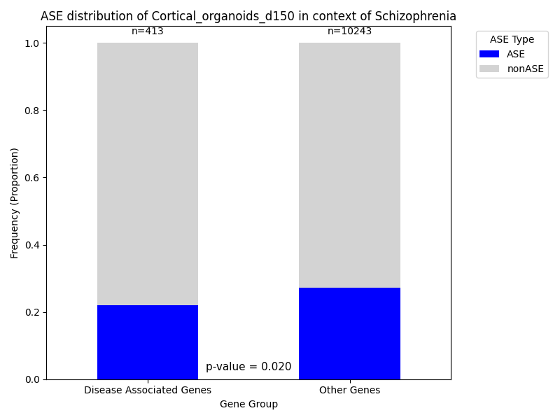
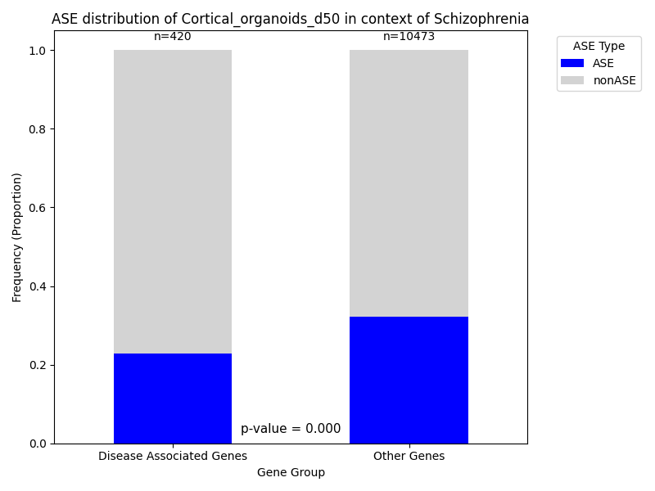
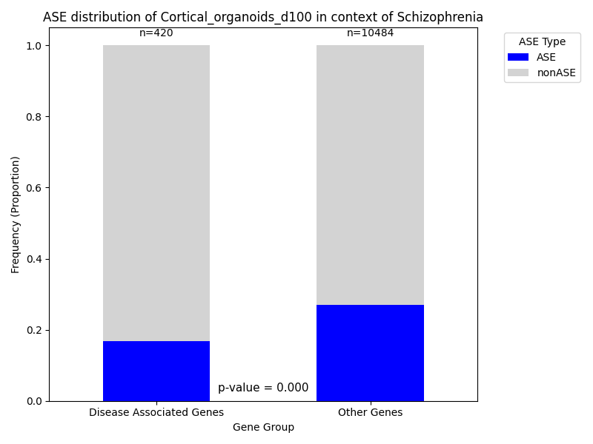
Less ASE genes in the disease-related list סלקציה נגד שינויים רגולטוריים בגנים שגורמים למחלות
Notes:
להדגיש שעברנו על המון מחלות, בכולן רואים את אותו טרנד ובחלקן גם סיגניפיקנטי (meta plot)?

Slide 12
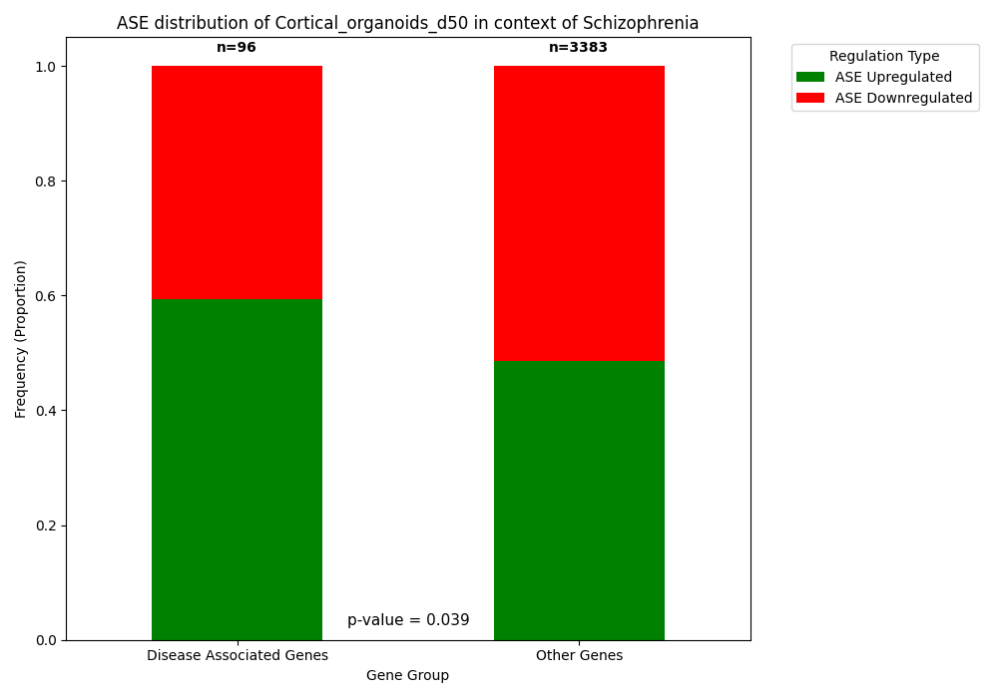
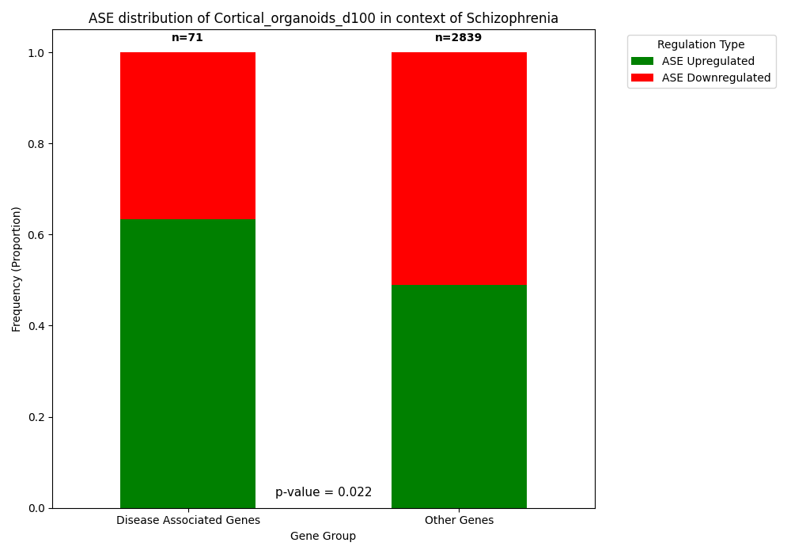
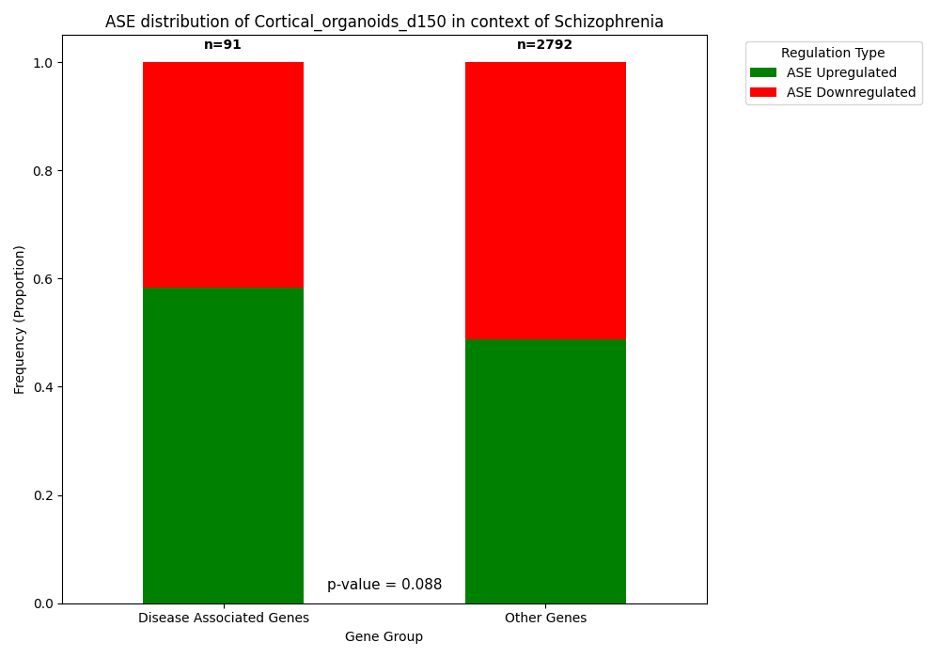
Strong selection against downregulation of genes
Notes:
ראינו רק בסכיזופרניה שיש גם סלקציה נגד down. מתאים לcliffedge וזה גם הגיוני שפה הסיגנל הכי חזק בגלל שלסכיזופרניה יש אפקט פיטנס הכי גדול מכל המחלות שבדקנו.

Slide 13
Using human-ape hybrids to study disease
Cliff-edge theory
Trade-off between adaptation and disease risk
Adaptive change
Fitness
Disease
Gene expression
Notes:
What could this trade-off be? Maybe the increase in the expression of these genes was adaptive and pushed you up the hill, but also closer to the cliff-edge, and then, if the expression increases slightly further due to environmental effects for example, you fall off the cliff and get the disease

Slide 14
Correlations: the bigger impact, the less chance to find ASE in disease-related genes
Check beta/OR for stronger relationship between disease and gene
Check LFC to check size of ASE impact (use absolute values of LFC)

Slide 15
Correlation: negative LFC has less chance to find disease-related ASE

Slide 16
The effect is stronger in early-development genes?

Slide 17
discussion
Strong selection against regulatory changes in disease-related genes
The selection is stronger against downregulation – usually genes are related to diseases when they are dysfunctional (LOF = no expression = downregulation)
This effect is strongest in schizophrenia (although exists to some extent in other diseases as well) because of the very strong fitness impact (impacts at a young age and they don’t get marriesd)
Cahnges in early development of the brain = probably has many effects on different pathways, so “positive” changes in one direction caused this appearance of schizophrenia which is “negative”

Slide 18
To be continued
Pathway enrichment analysis
When are these genes expressed (developmental stages)?

Slide 19
thanks

